Slide 1
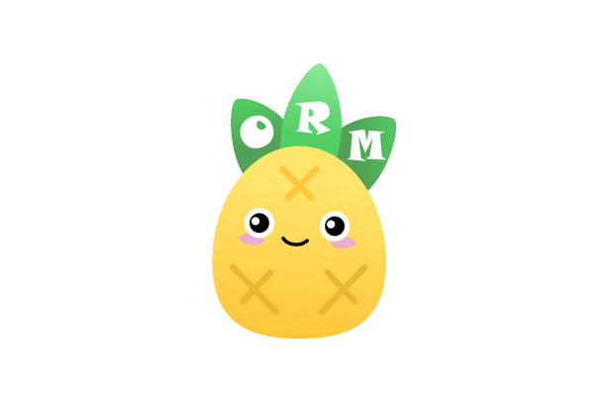
VUE PINIA

Slide 2
What is Pinia?
A store library for Vue
Share state across components and pages
Can create global state with simple export constant store

Slide 3
Why Pinia?
Multiple Storage Creation
External storing module organization
Don’t need to mess up with props, emit, provide, or inject
Learn more the usage of arrow functions

Slide 4
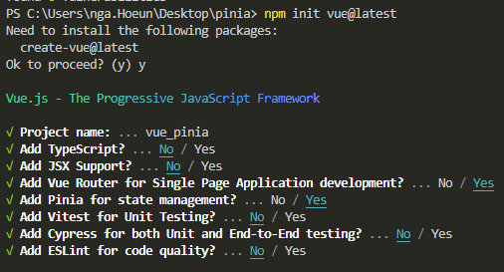
Installation

Slide 5
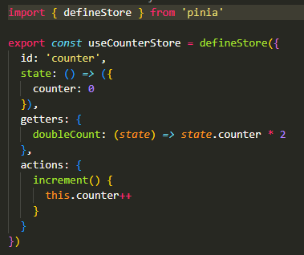
Defining a Store
Import defineStore from pinia
Export an object created by the defineStore
Pass option objects into the object with state, getter, and actions.

Slide 6
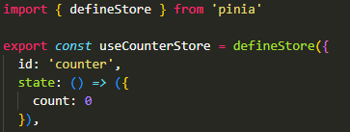

State
Function that returns the initial state. (Data)
Store reactive data
Access using only
storeVariableName.count

Slide 7
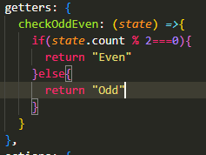
Getter
Computed values for the states in the store
Can return back a function so argument can be pass into

Slide 8
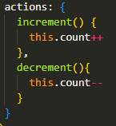
Actions
Equivalent to methods in component
Used mostly to define business logic
Call the same way as states and getters.

Slide 9
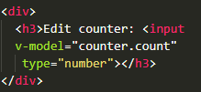
Two Way Binding

Slide 10
Login/Logout
https://jasonwatmore.com/post/2022/07/25/vue-3-pinia-user-registration-and-login-example-tutorial

Slide 11
Demostration
Counter App

Slide 12
References
https://jasonwatmore.com/post/2022/07/25/vue-3-pinia-user-registration-and-login-example-tutorial
https://www.youtube.com/watch?v=JGC7aAC-3y8
https://pinia.vuejs.org/

